Slide 1
The Future of Housing
Zurich‘s Young Cooperatives Movement
Philipp Klaus, Kraftwerk 1 Housing Coop , Zurich
INDI.CAT
Viladecans
May 3, 2018
KraftWerk1 Project in Zurich
Notes:
1

Slide 2
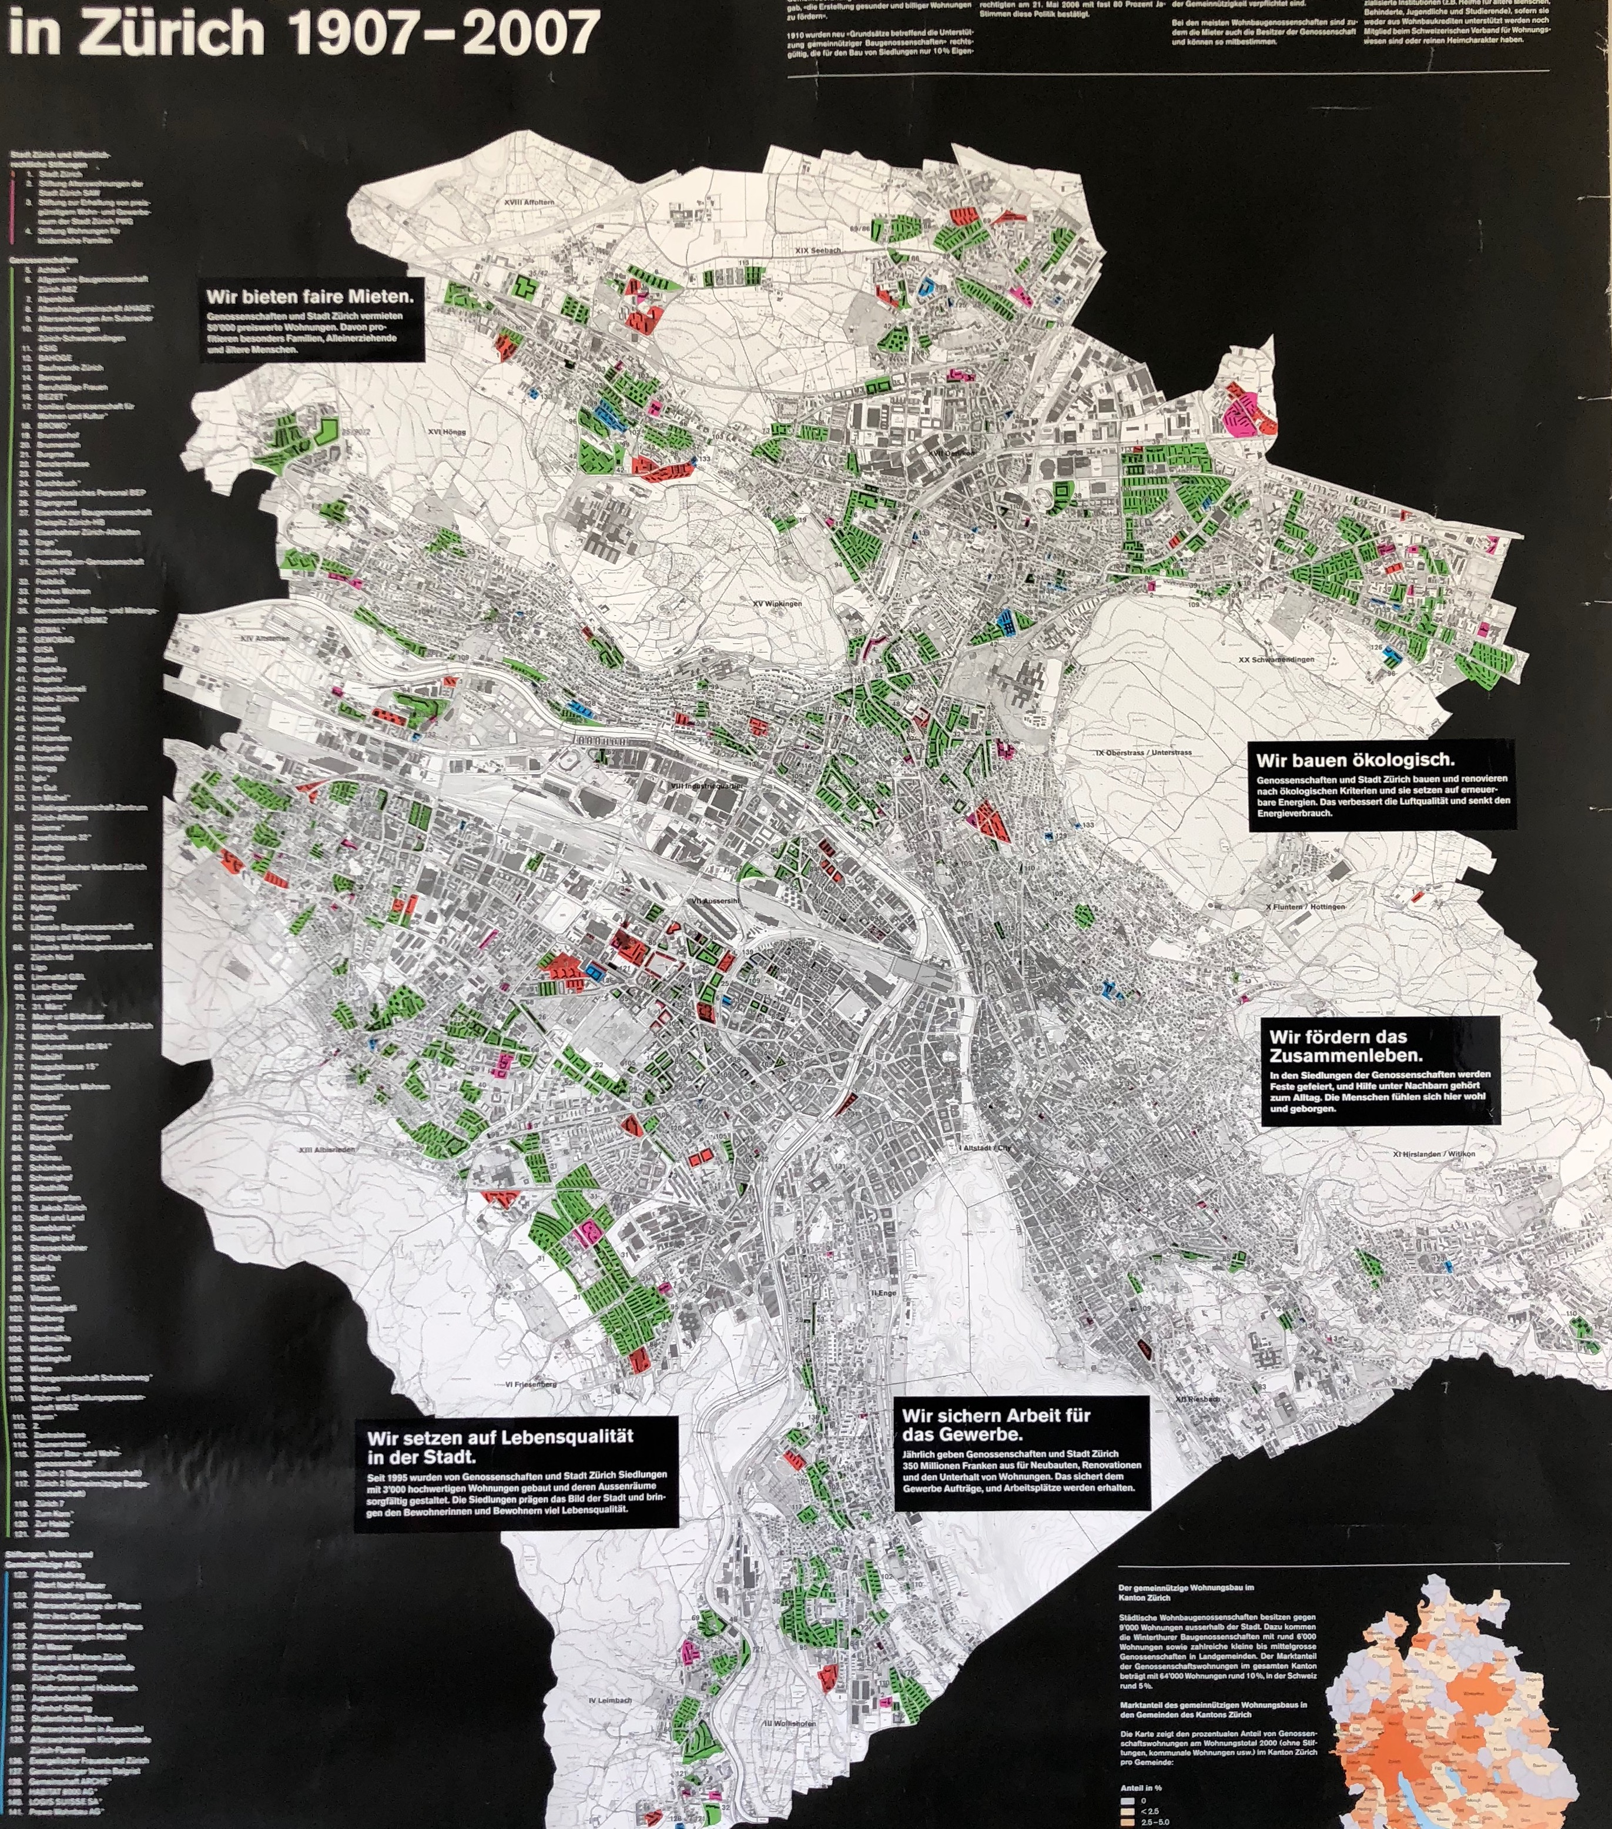
= Housing
Cooperatives
Zurich
1907-2007
Dr. Philipp Klaus, Kraftwerk 1 Housing Coop , INURA Zurich Institute // May 3, 2018 // INDI-CAT Conference, Viladecans, Barcelona Province.
Notes:
2

Slide 3
Housing in Zurich today
Figures City of Zurich
Population 420‘000
Flats 220‘000
Rented 190‘000
Flats in
Cooperatives 40‘000
Dr. Philipp Klaus, Kraftwerk 1 Housing Coop , INURA Zurich Institute // May 3, 2018 // INDI-CAT Conference, Viladecans, Barcelona Province.
Notes:
3

Slide 4
Housing Coops: The 3rd Way
1
House Ownership
Private
Companies
2
Tenants
Renting from Owners
3
Housing Cooperatives
Collective Ownership
Renting Flat from Cooperative
Dr. Philipp Klaus, Kraftwerk 1 Housing Coop , INURA Zurich Institute // May 3, 2018 // INDI-CAT Conference, Viladecans, Barcelona Province.
Notes:
4

Slide 5
Housing Coops: The 3rd Way
3
Housing Cooperatives
Collective Ownership
Renting Flat from Cooperative
Example Kraftwerk1
Membership Fee / Share
CHF 500.-
Compulsory contribution to the flat
CHF 20‘000.- (paid back
when leaving)
Rent for flat of 75m² 14.-/m2/month
= 20–30 % below average rent in city
Includes shared spaces
Dr. Philipp Klaus, Kraftwerk 1 Housing Coop , INURA Zurich Institute // May 3, 2018 // INDI-CAT Conference, Viladecans, Barcelona Province.
Notes:
5

Slide 6
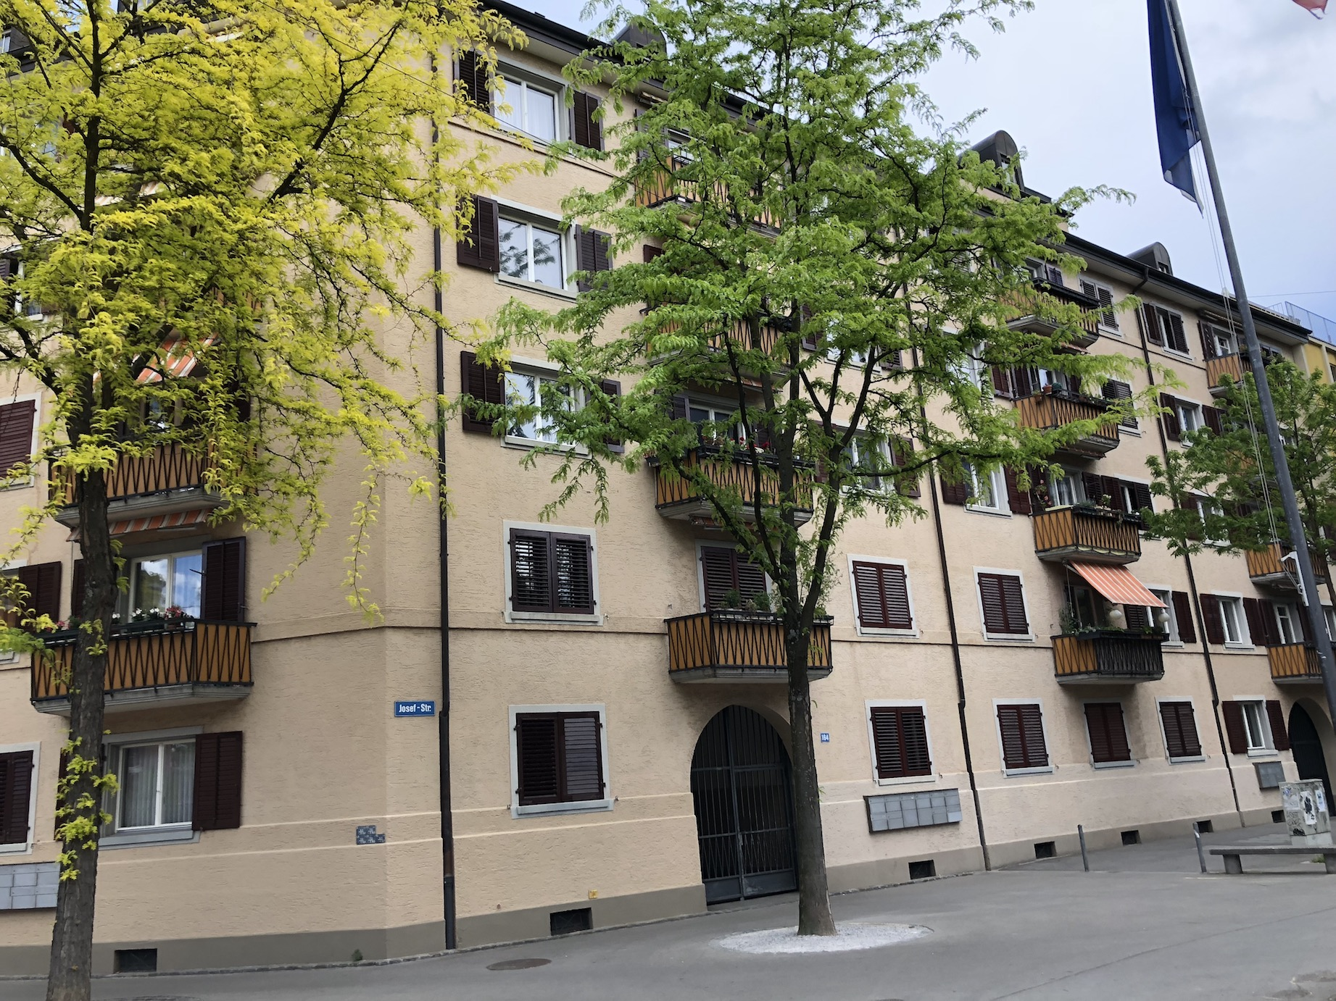
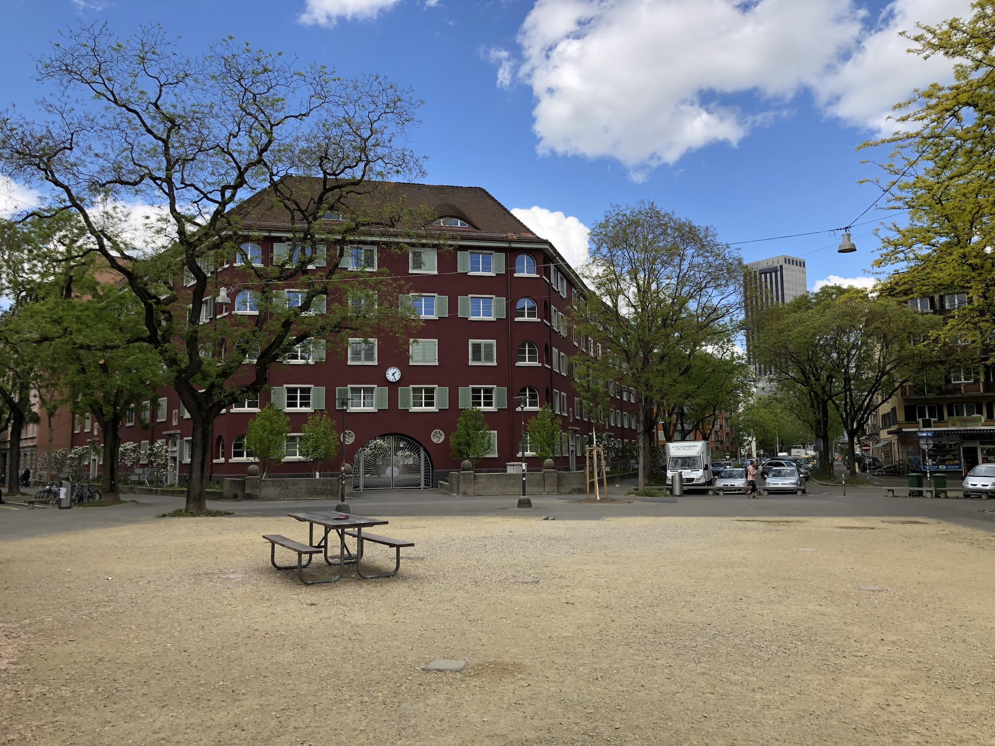
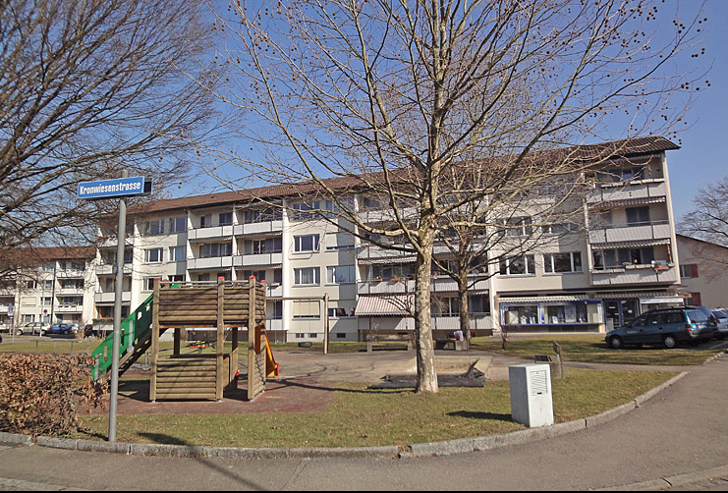
Housing Coops: The 3rd Way
1920
1907
1950
Dr. Philipp Klaus, Kraftwerk 1 Housing Coop , INURA Zurich Institute // May 3, 2018 // INDI-CAT Conference, Viladecans, Barcelona Province.
Notes:
6

Slide 7
KraftWerk1 Project in Zurich
Innovation:
Zürich‘s young cooperatives movement
Dr. Philipp Klaus, Kraftwerk 1 Housing Coop , INURA Zurich Institute // May 3, 2018 // INDI-CAT Conference, Viladecans, Barcelona Province.
Notes:
7

Slide 8
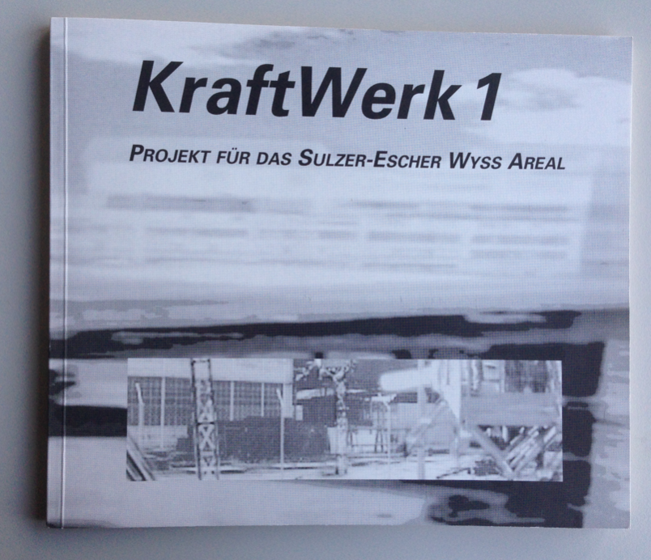
1993: Martin Blum, Andreas Hofer & P.M. KraftWerk1 Project
Dr. Philipp Klaus, Kraftwerk 1 Housing Coop , INURA Zurich Institute // May 3, 2018 // INDI-CAT Conference, Viladecans, Barcelona Province.
Martin Blum, Andreas Hofer & P.M. 1993, KraftWerk1 Project
Martin Blum, Andreas Hofer & P.M. 1993, KraftWerk1 Project
Martin Blum, Andreas Hofer & P.M. 1993, KraftWerk1 Project
Notes:
8

Slide 9
KraftWerk1 Project in Zurich
Dr. Philipp Klaus, Kraftwerk 1 Housing Coop , INURA Zurich Institute // May 3, 2018 // INDI-CAT Conference, Viladecans, Barcelona Province.
Notes:
9

Slide 10
1994c
How to answer to pressing questions such as
Environment? Urban sprawl, transportation, ...
Concentration of power? Globalisation, global cities
Social issues? Rents, Communities
Self organisation? Participation
Urban Quality? What citiy do we want to live in?
Volatility of the housing market?
How to make utopia become reality?
KraftWerk1 Project in Zurich
Dr. Philipp Klaus, Kraftwerk 1 Housing Coop , INURA Zurich Institute // May 3, 2018 // INDI-CAT Conference, Viladecans, Barcelona Province.
Notes:
10

Slide 11
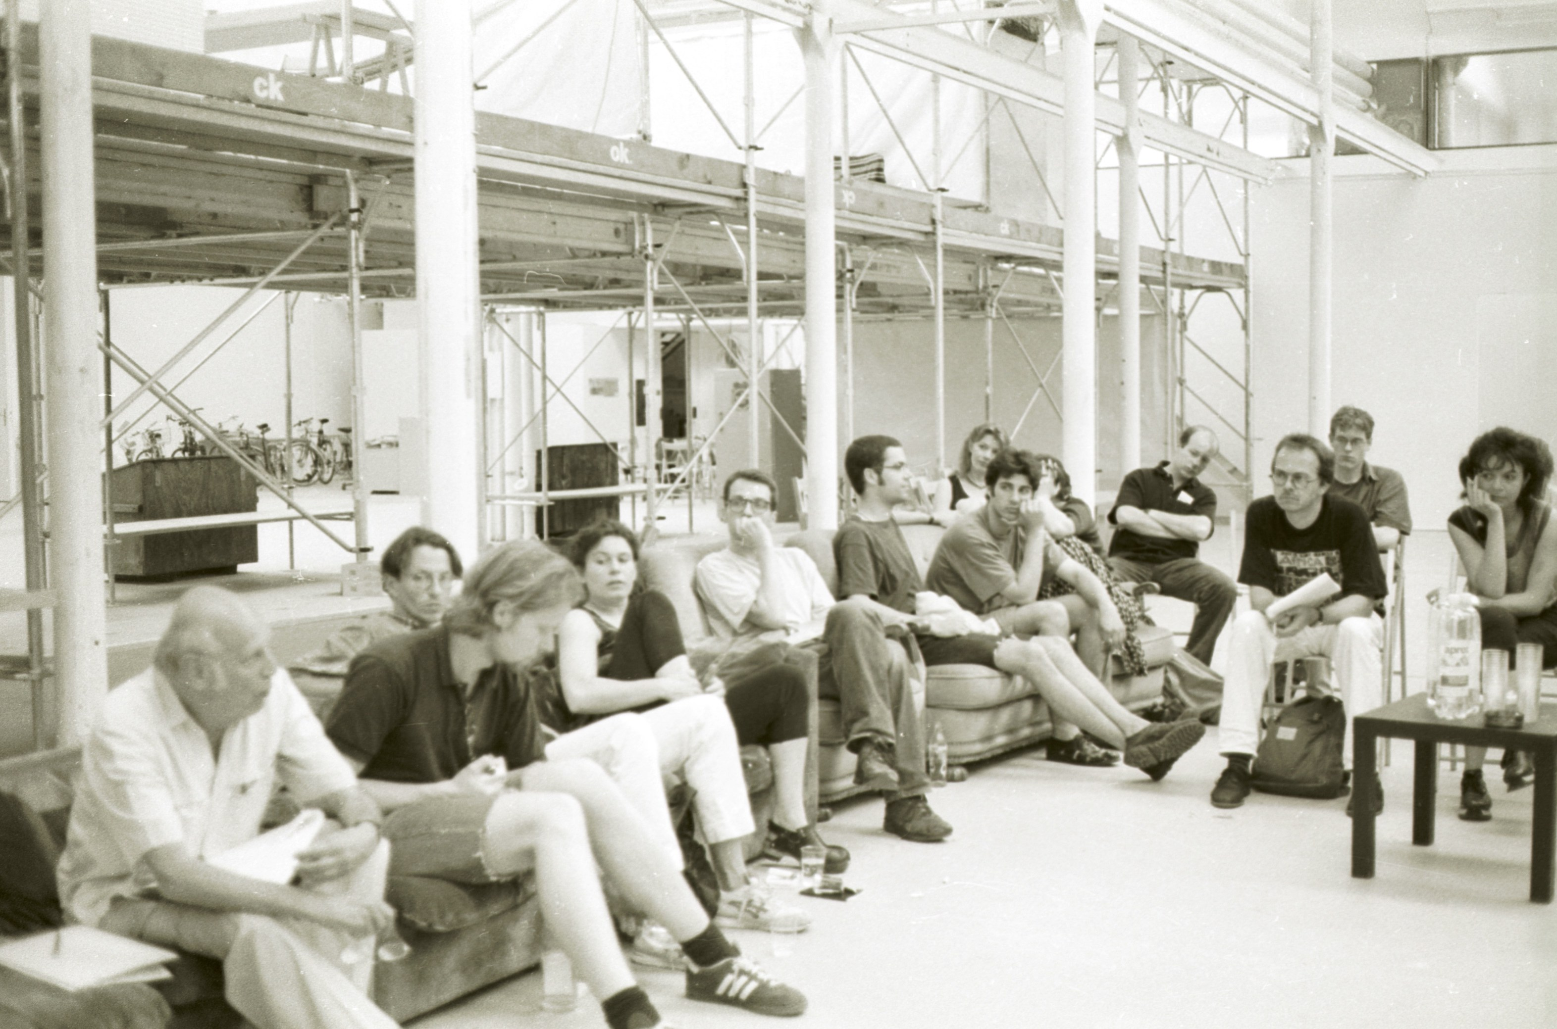
1995 Sofa University
KraftWerk1 Project in Zurich
Dr. Philipp Klaus, Kraftwerk 1 Housing Coop , INURA Zurich Institute // May 3, 2018 // INDI-CAT Conference, Viladecans, Barcelona Province.
Notes:
11

Slide 12
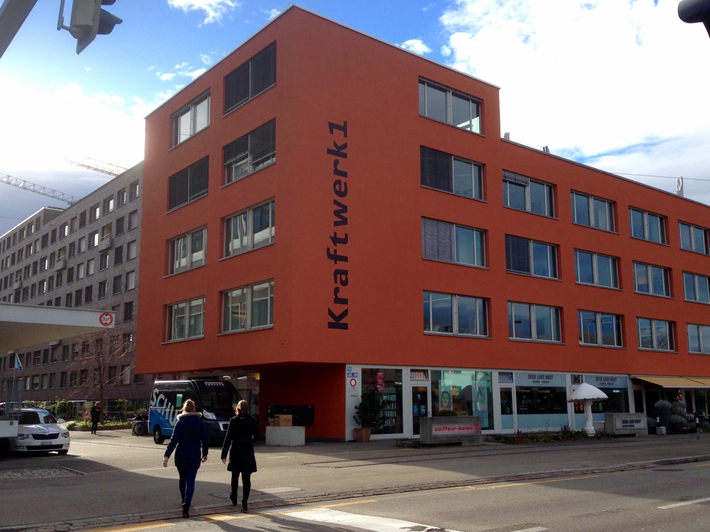
Dr. Philipp Klaus, Kraftwerk 1 Housing Coop , INURA Zurich Institute // May 3, 2018 // INDI-CAT Conference, Viladecans, Barcelona Province.
Notes:
12

Slide 13
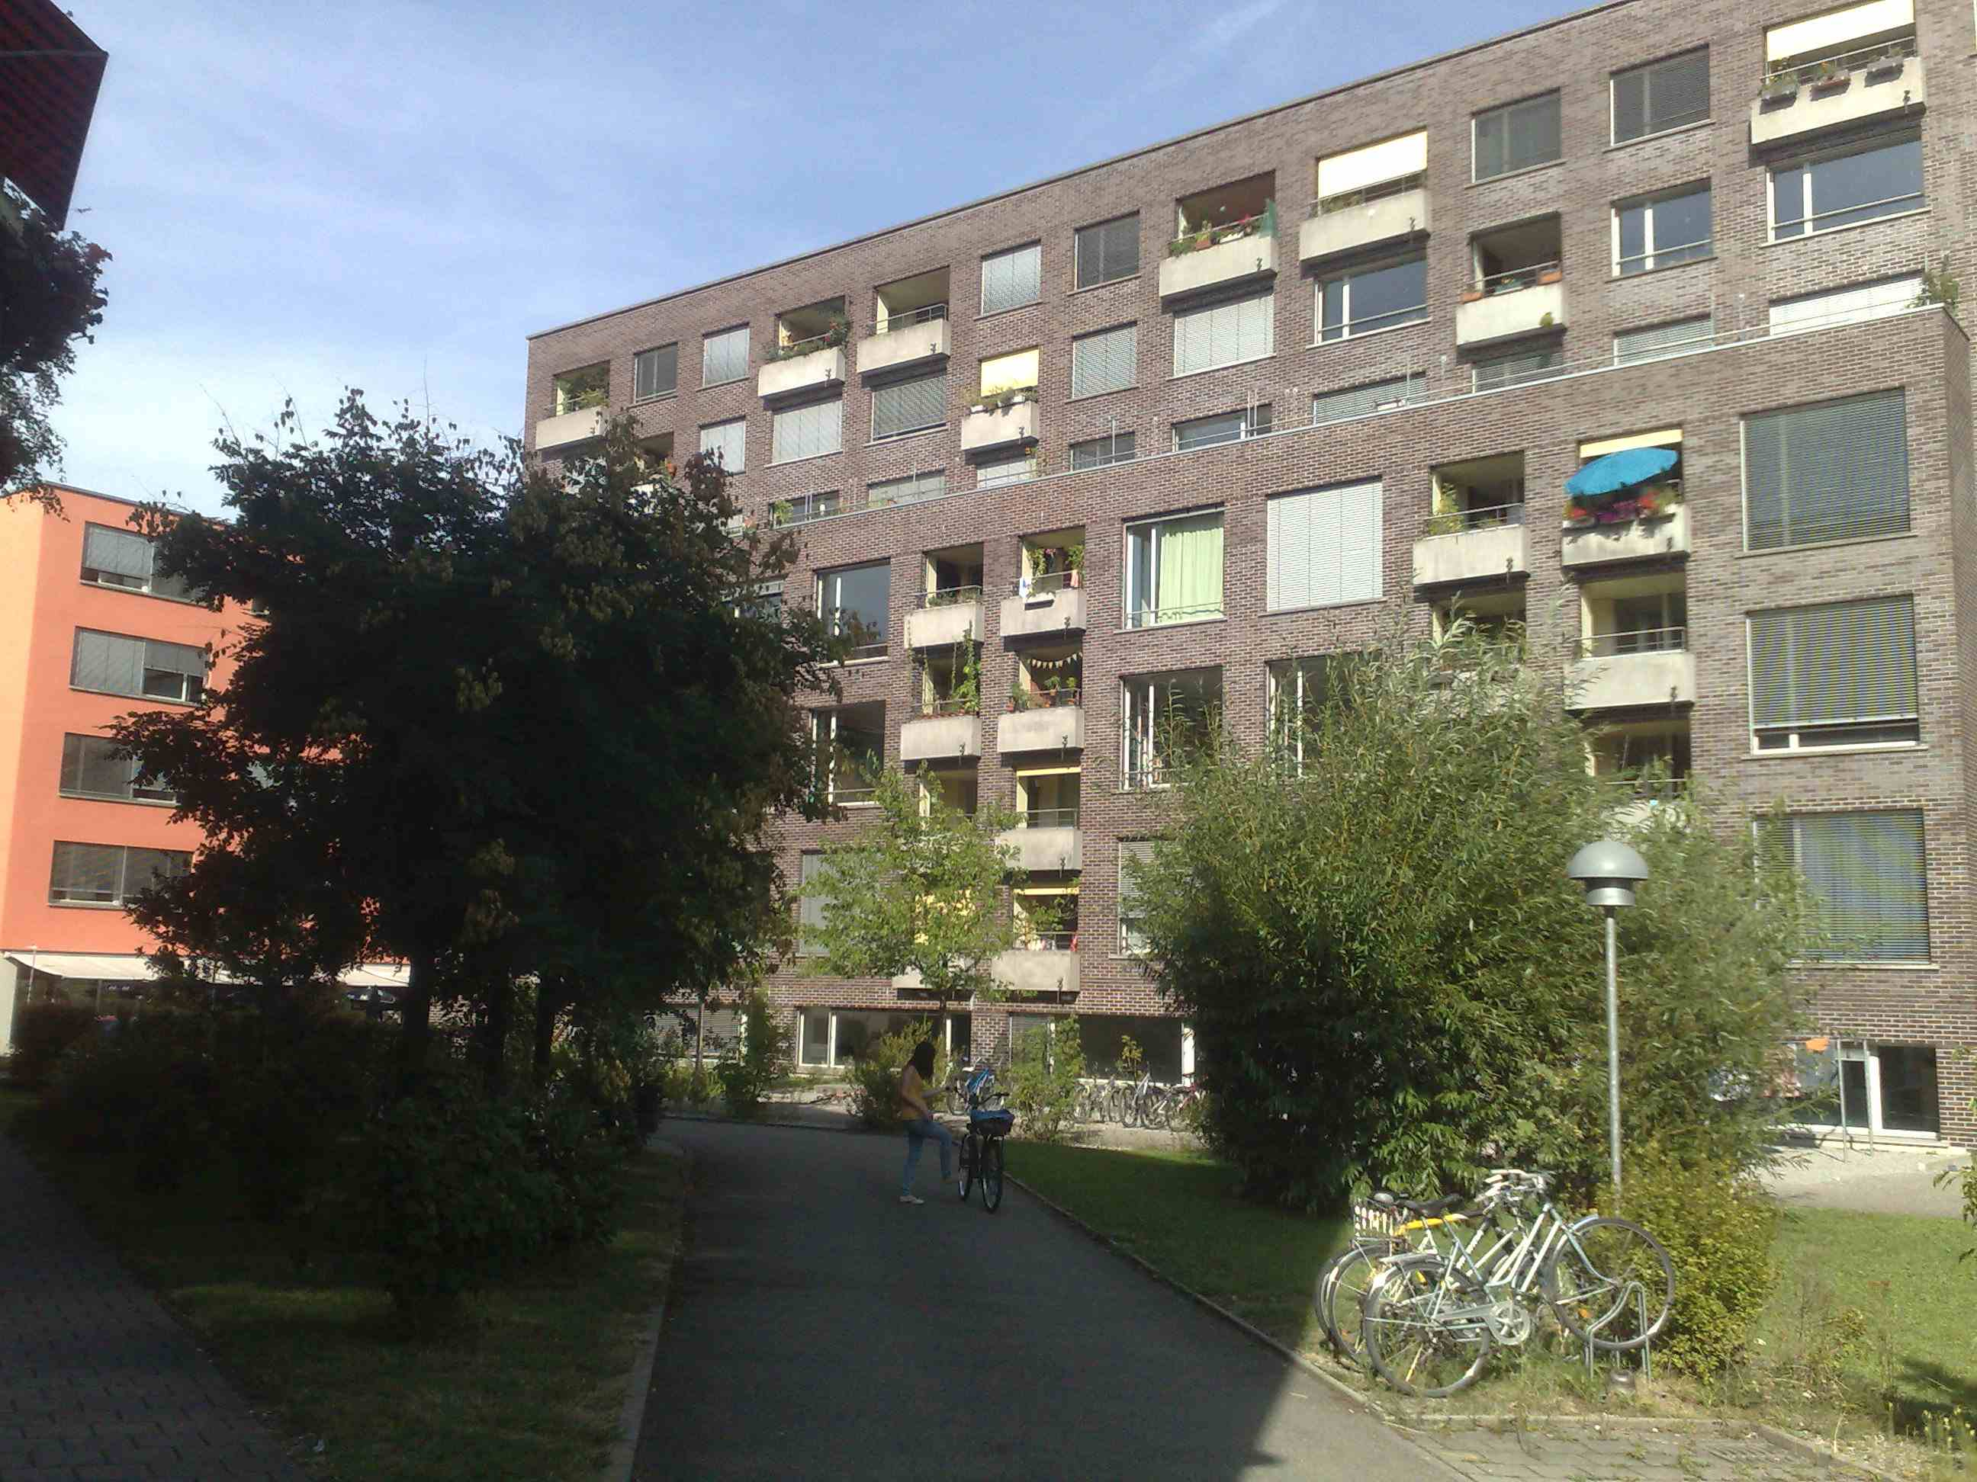
KraftWerk1 Project in Zurich
Dr. Philipp Klaus, Kraftwerk 1 Housing Coop , INURA Zurich Institute // May 3, 2018 // INDI-CAT Conference, Viladecans, Barcelona Province.
Notes:
13

Slide 14
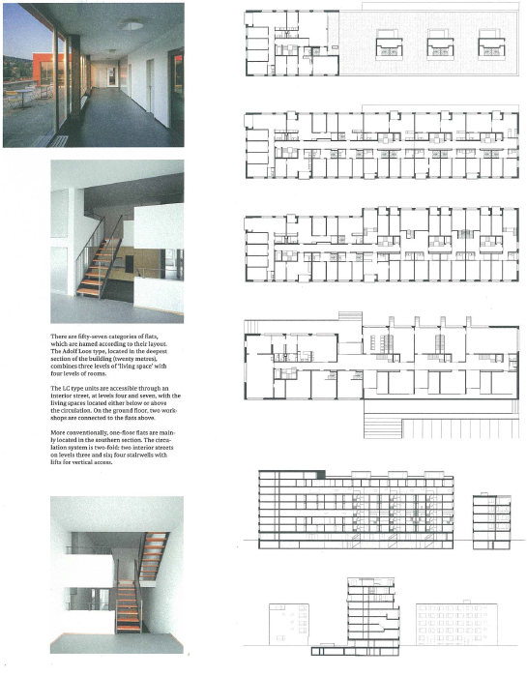
81 Flats
Rooms Quantity
1 7
2.5 6
3.5 16
4.5 20
5.5 15
6.5 9
7.5 3
8.5 1
9.5 1
12.5 2
13.5 1
Dr. Philipp Klaus, Kraftwerk 1 Housing Coop , INURA Zurich Institute // May 3, 2018 // INDI-CAT Conference, Viladecans, Barcelona Province.
Notes:
14

Slide 15
Diversity, mixed uses
KraftWerk1 – Restaurant
Notes:
15

Slide 16
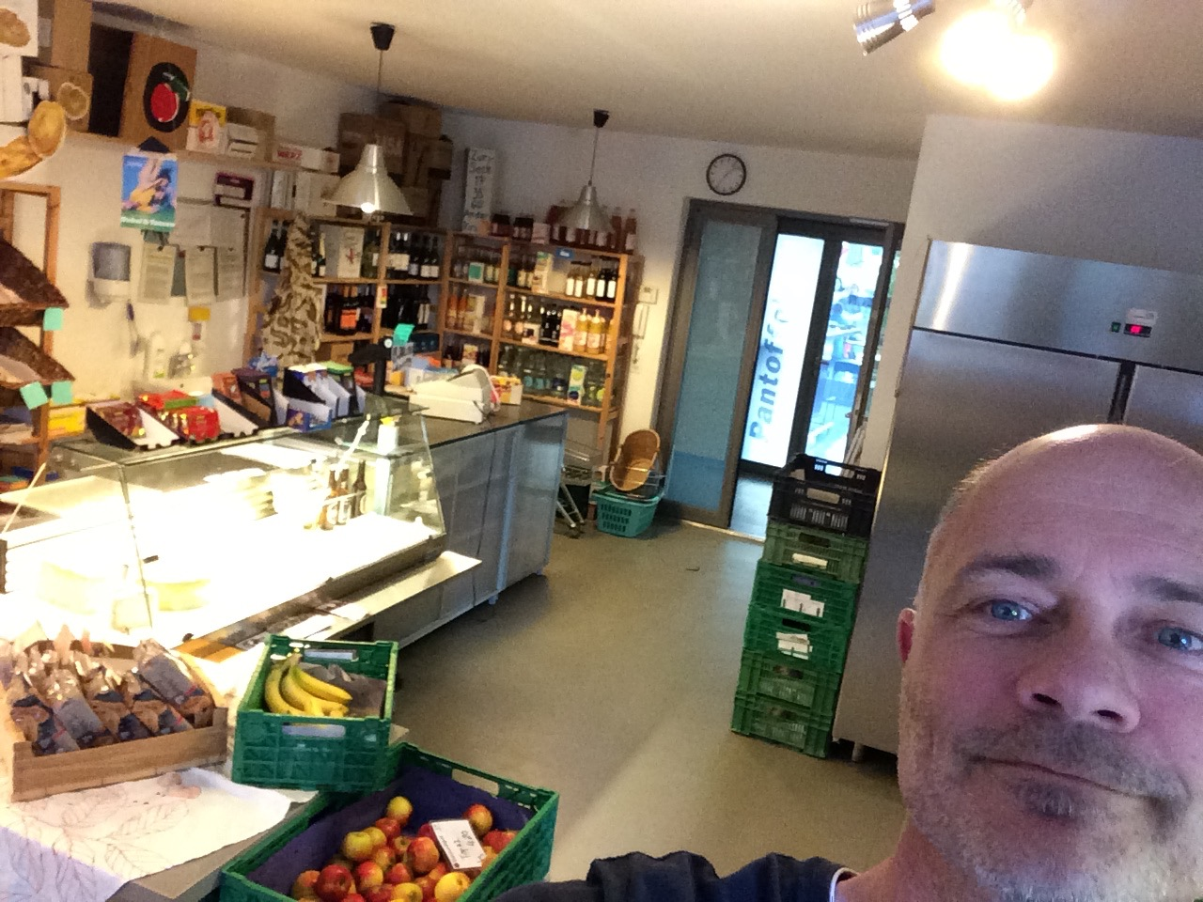
KraftWerk1 – Shop
Notes:
16

Slide 17
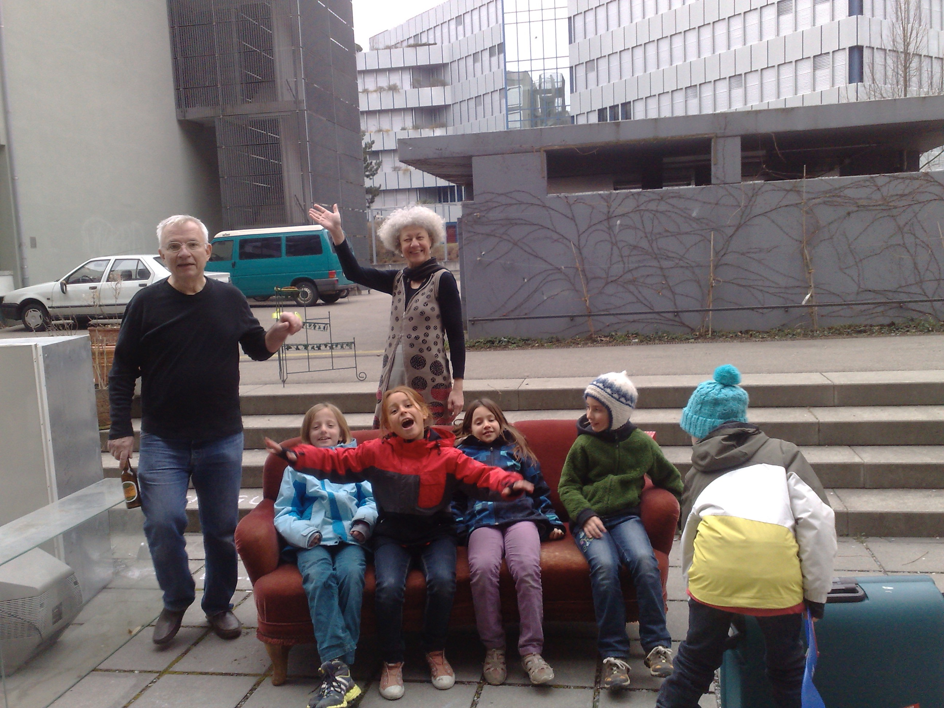
KraftWerk1 – Recycling Day
Notes:
17

Slide 18
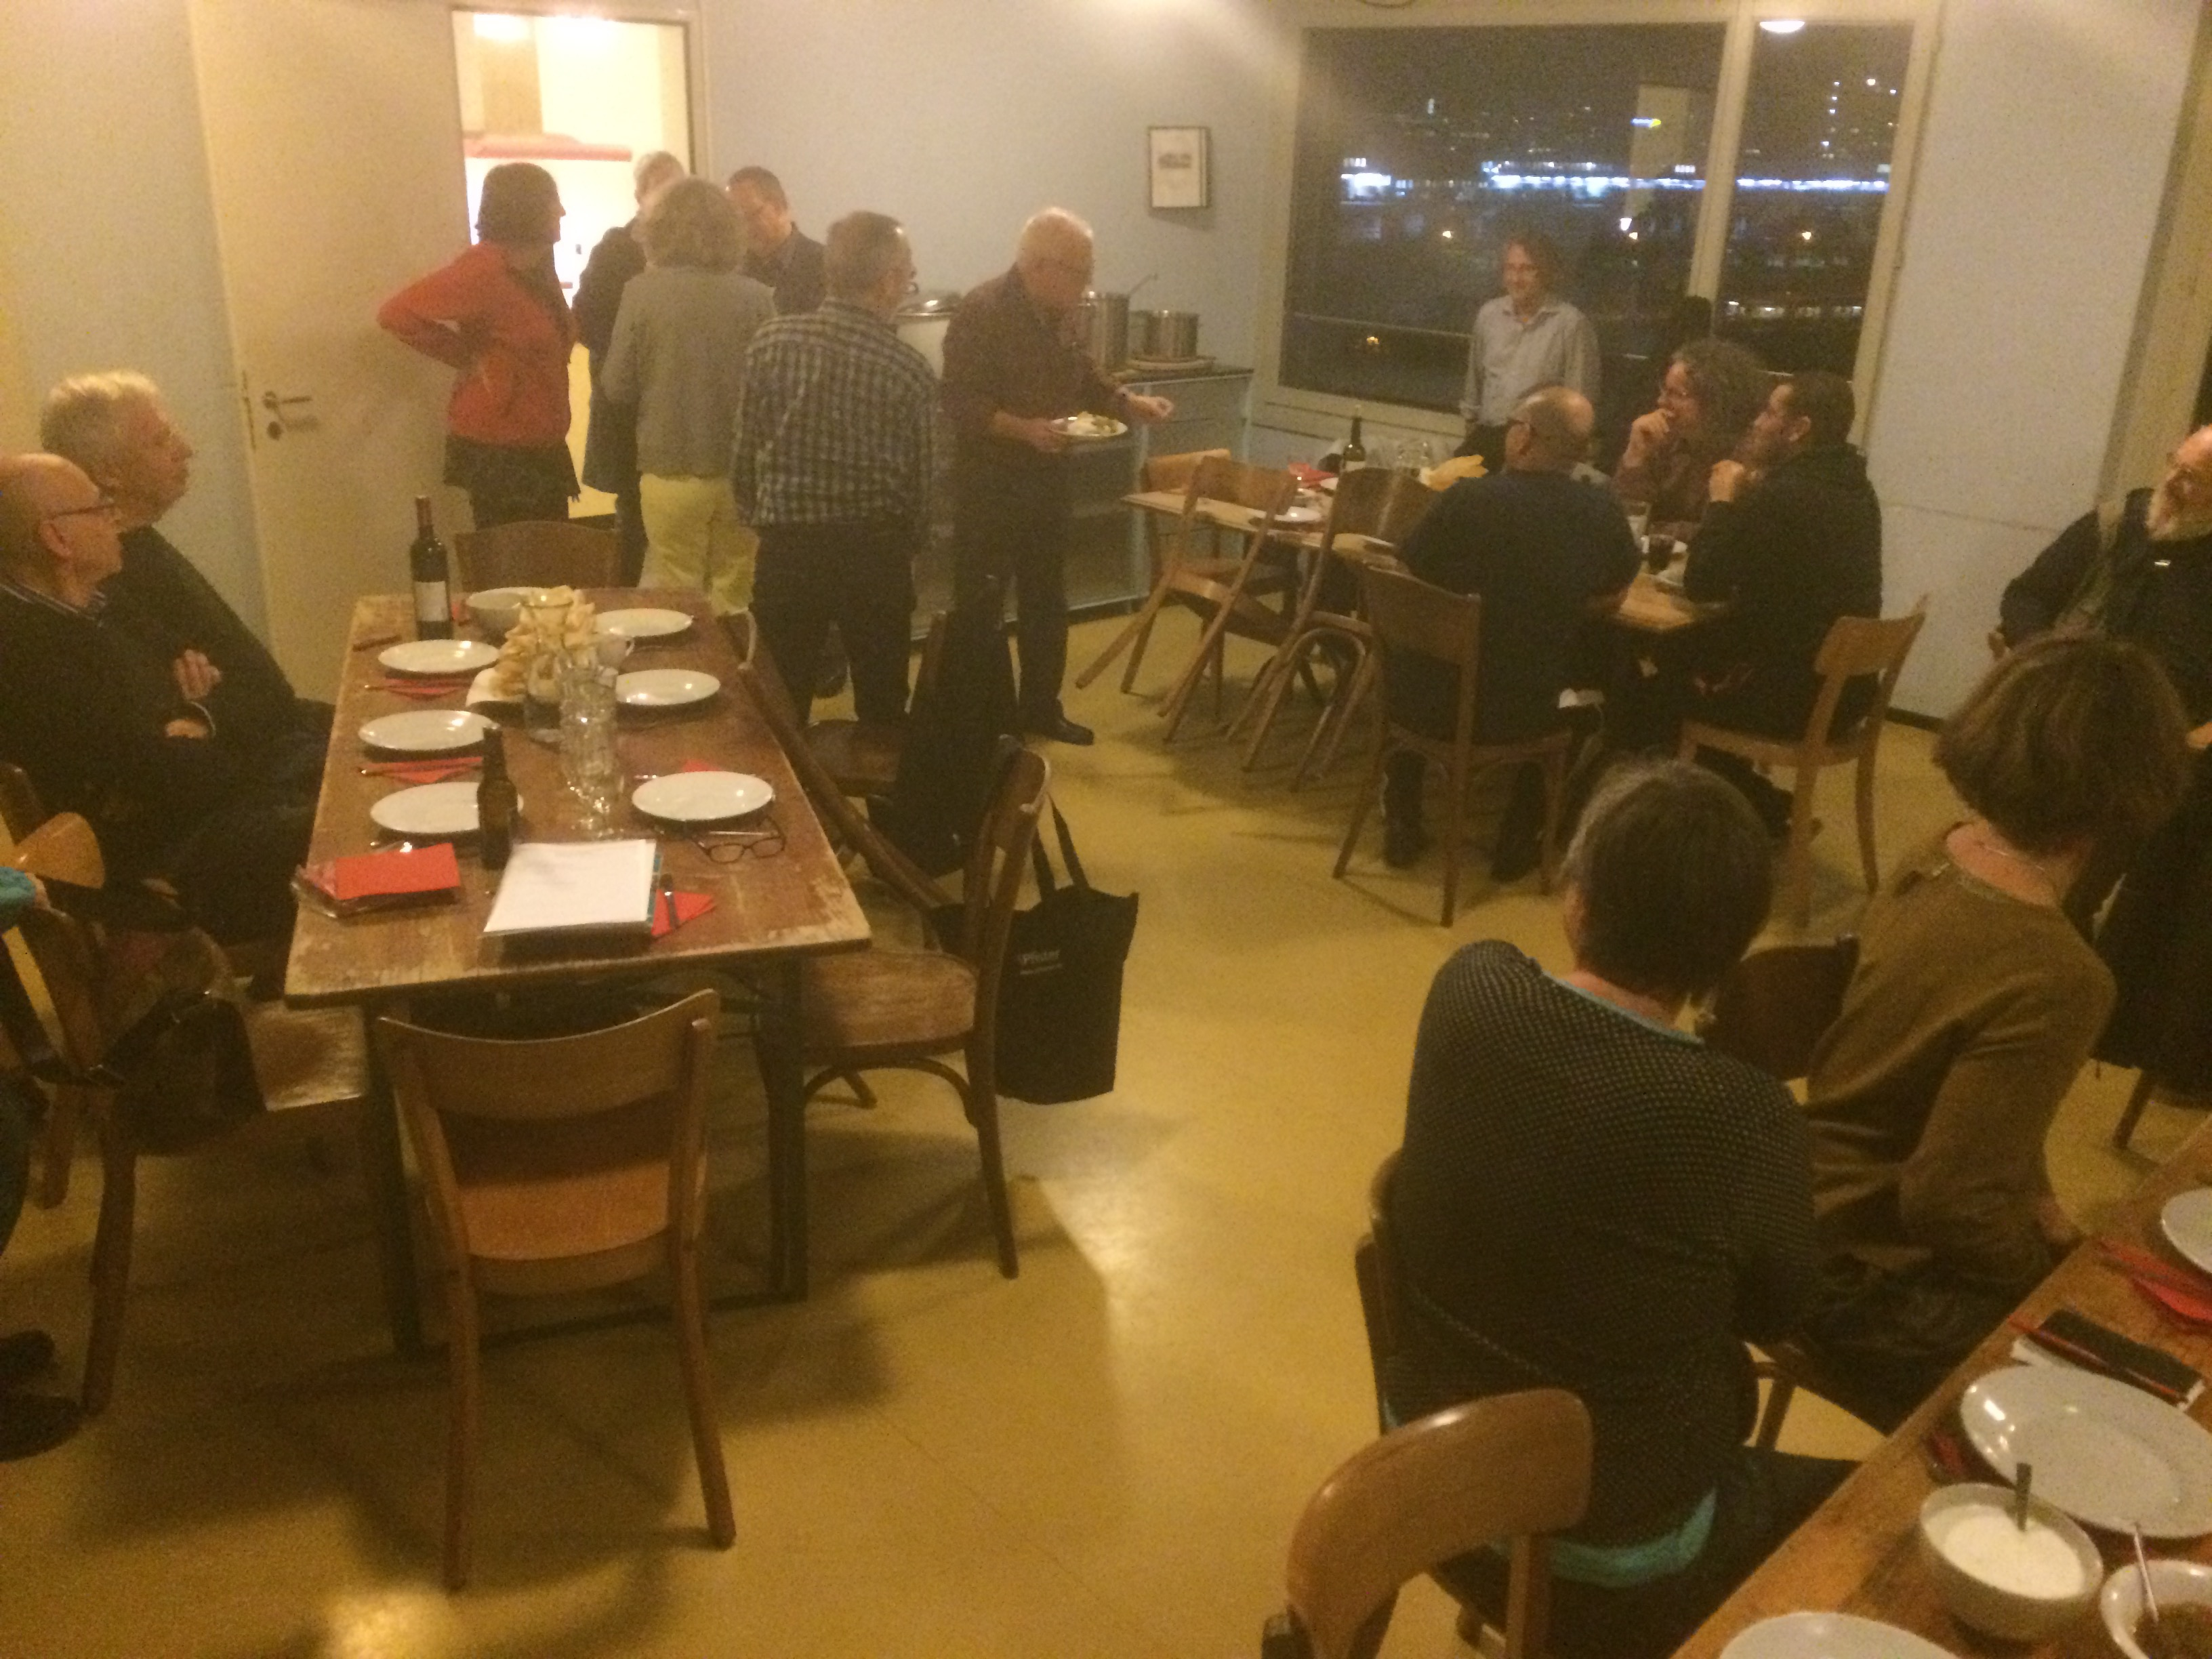
KraftWerk1 – Kitchen Club
Notes:
18

Slide 19
Shops and offices
Dr. Philipp Klaus, Kraftwerk 1 Housing Coop , INURA Zurich Institute // May 3, 2018 // INDI-CAT Conference, Viladecans, Barcelona Province.
Notes:
19

Slide 20
Innovation
All kinds of flats from Studio to 13 room flat
→ huge variety of inhabitants (old, young, ...)
Other uses than just housing
→ Living and working in the same area
Flat change conference
Dr. Philipp Klaus, Kraftwerk 1 Housing Coop , INURA Zurich Institute // May 3, 2018 // INDI-CAT Conference, Viladecans, Barcelona Province.
Notes:
20

Slide 21
Social Concepts
Solidarity Funds → Support the weaker ones
Collaboration with social institutions - public and private // Flats for handicapped, refugees, ...
Affordable rents help people not getting dependent on the welfare state
Dr. Philipp Klaus, Kraftwerk 1 Housing Coop , INURA Zurich Institute // May 3, 2018 // INDI-CAT Conference, Viladecans, Barcelona Province.
Notes:
21

Slide 22
Sustainability
Number of rooms minus 1 = number of inhabitants
Reduced car ownership / parking
Solar pannels
Recuperation of heated air
Dr. Philipp Klaus, Kraftwerk 1 Housing Coop , INURA Zurich Institute // May 3, 2018 // INDI-CAT Conference, Viladecans, Barcelona Province.
Notes:
22

Slide 23
STRUCTURES
Notes:
23

Slide 24
Cooperative
Kraftwerk1
founded 1995
ca. 1200 members in 2018
KraftWerk1 Project in Zurich
Notes:
24

Slide 25
Unit 1
since 2001
270 inhabitants
90 workplaces
Cooperative
Kraftwerk1
founded 1995
ca. 1200 members in 2018
KraftWerk1 Project in Zurich
Notes:
25

Slide 26
Unit 1
since 2001
270 inhabitants
90 workplaces
Cooperative
Kraftwerk1
founded 1995
ca. 1200 members in 2018
KraftWerk1 Project in Zurich
Unit 2
Since 2012
85 inhabitants
5 workplaces
Notes:
26

Slide 27
Unit 1
since 2001
270 inhabitants
90 workplaces
Cooperative
Kraftwerk1
founded 1995
ca. 1200 members in 2018
KraftWerk1 Project in Zurich
Unit 3
since 2015
ca. 450 inhabitants
ca. 120 workplaces
Unit 2
Since 2012
85 inhabitants
5 workplaces
Notes:
27

Slide 28
Organisation in Kraftwerk1:
FullAssembly of the members
1 x / year
- Elections to the Board
- Annual Account and Budget
- Projects
Cooperative
Kraftwerk1
founded 1995
ca. 1200 members in 2018
Notes:
28

Slide 29
Organisation in Kraftwerk1:
FullAssembly of the members
1 x / year
- Elections to the Board
- Annual Account and Budget
- Projects
Cooperative
Kraftwerk1
founded 1995
ca. 1200 members in 2018
Board
7 members
Board
7 members
Notes:
29

Slide 30
Organisation in Kraftwerk1:
FullAssembly of the members
1 x / year
- Elections to the Board
- Annual Account and Budget
- Projects
Cooperative
Kraftwerk1
founded 1995
ca. 800 members
Board
7 members
Office
Employed staff
6 persons
Notes:
30

Slide 31
Organisation in Kraftwerk1, Unit 1:
Working
Groups
Committees,
Commissions
Tenants Assembly
4-6x / year
Tenants
Inhabitants
Small Businesses
Unit 1
since 2001
270 inhabitants
90 workplaces
inura
Notes:
31

Slide 32
Working Groups and Committees
Core group (organising the assemblies)
Aktionstag (organising the common work days)
Committee choosing new residents
Work around the buildings
Circolo - cooking and eating together, 40 people
Roof top garden
Community rooms
Filmclub
Konsumdepot (self-managed store)
Pantoffelbar (ground floor bar)
AG Velo (bycicle repair and garage)
Ad hoc groups
Working
Groups
Committees,
Commissions
inura
Notes:
32

Slide 33
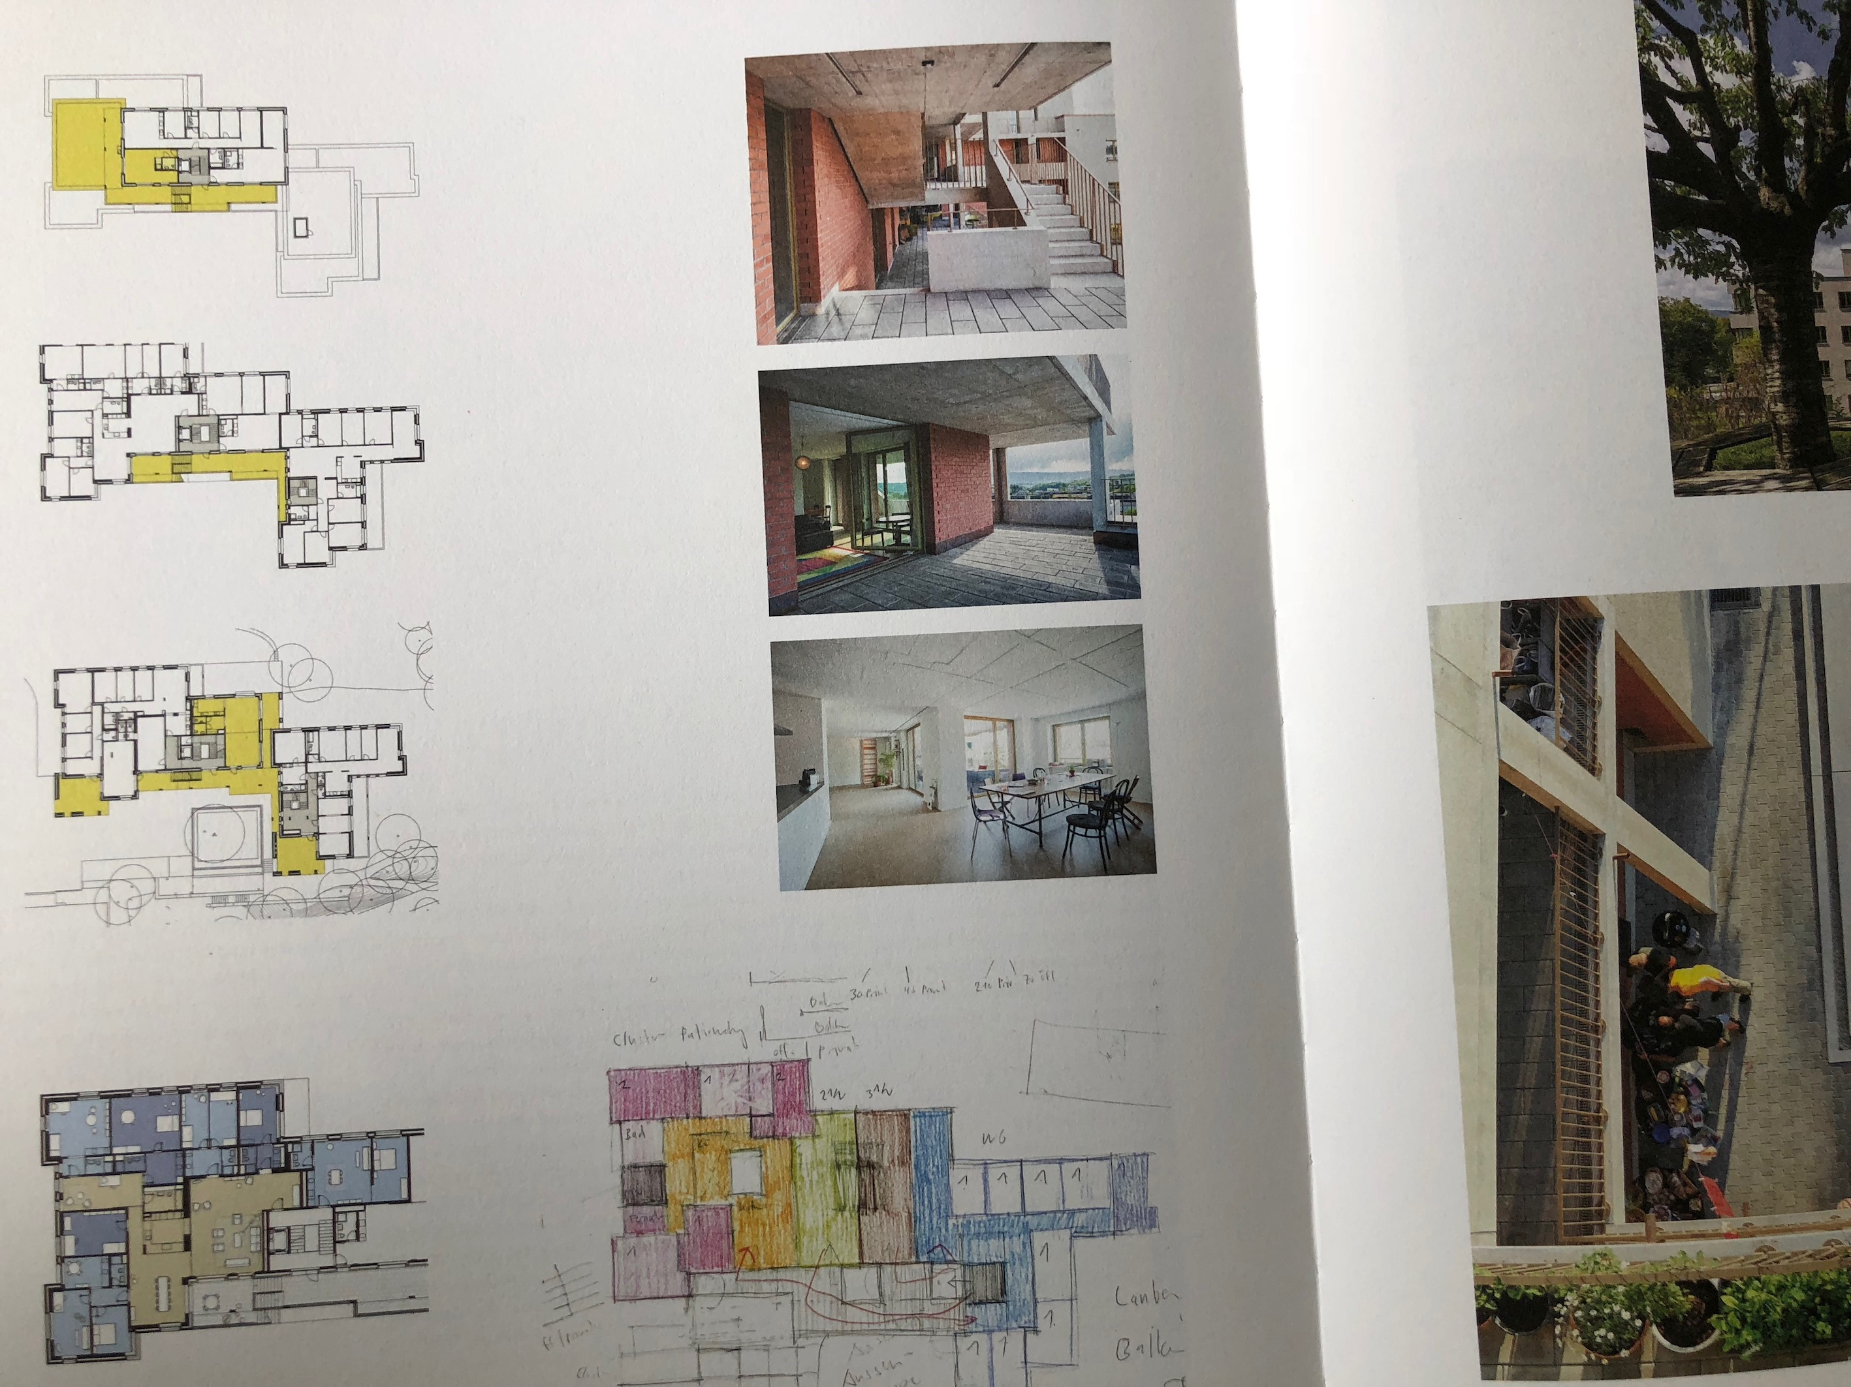
Kraftwerk1
2012
Unit 2
Notes:
33
New platform caused the collapse of the sign up system for the Konsumdepot, our shop.

Slide 34
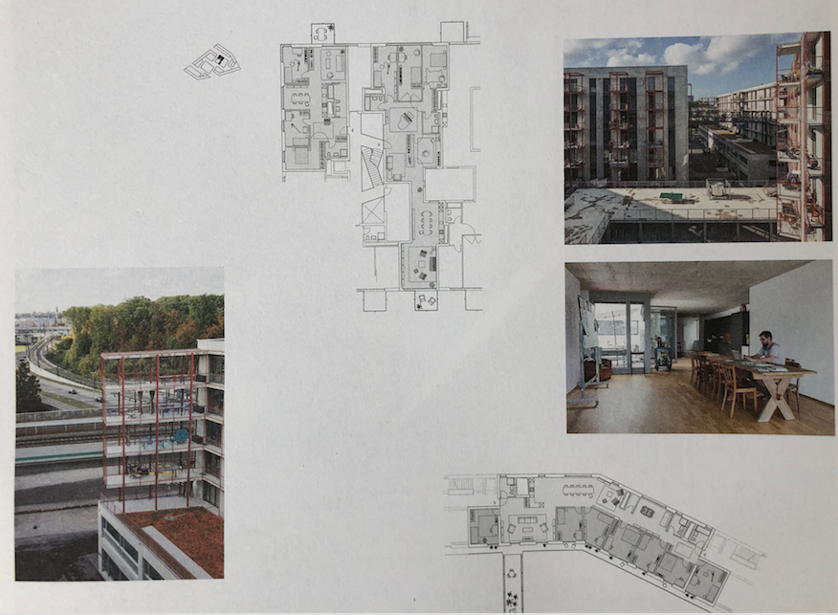
Kraftwerk1
2015
Unit 3
Notes:
34
New platform caused the collapse of the sign up system for the Konsumdepot, our shop.

Slide 35
Kraftwerk1
Future
Unit 4
Notes:
35
New platform caused the collapse of the sign up system for the Konsumdepot, our shop.

Slide 36
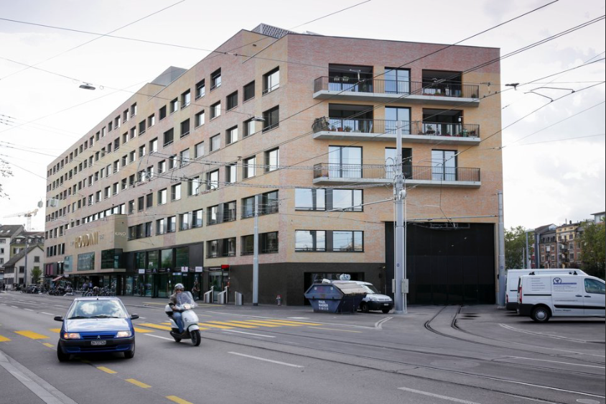
Finding Land ...
Dr. Philipp Klaus, Kraftwerk 1 Housing Coop , INURA Zurich Institute // May 3, 2018 // INDI-CAT Conference, Viladecans, Barcelona Province.
Notes:
36

Slide 37
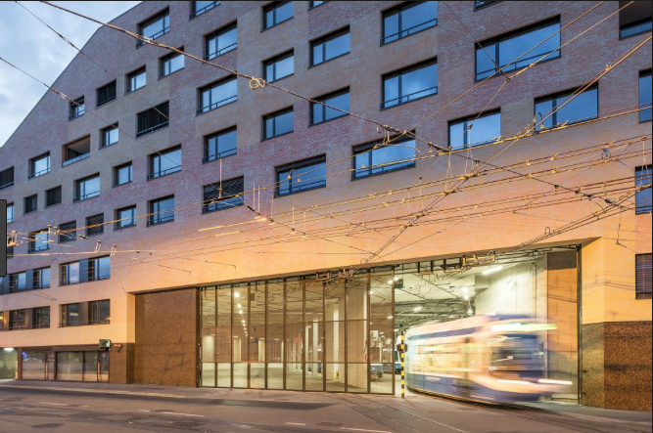
More than Housing!
Finding Land ...
Dr. Philipp Klaus, Kraftwerk 1 Housing Coop , INURA Zurich Institute // May 3, 2018 // INDI-CAT Conference, Viladecans, Barcelona Province.
Notes:
37

Slide 38
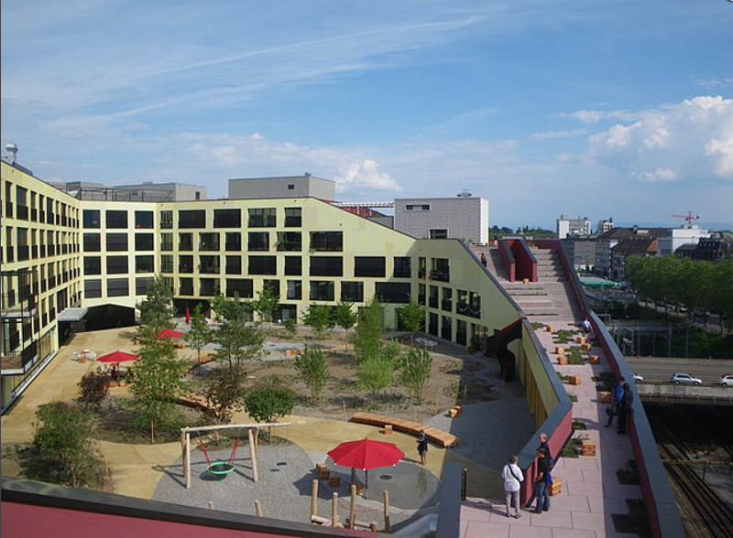
More than Housing!
Finding Land ...
Dr. Philipp Klaus, Kraftwerk 1 Housing Coop , INURA Zurich Institute // May 3, 2018 // INDI-CAT Conference, Viladecans, Barcelona Province.
Notes:
38

Slide 39
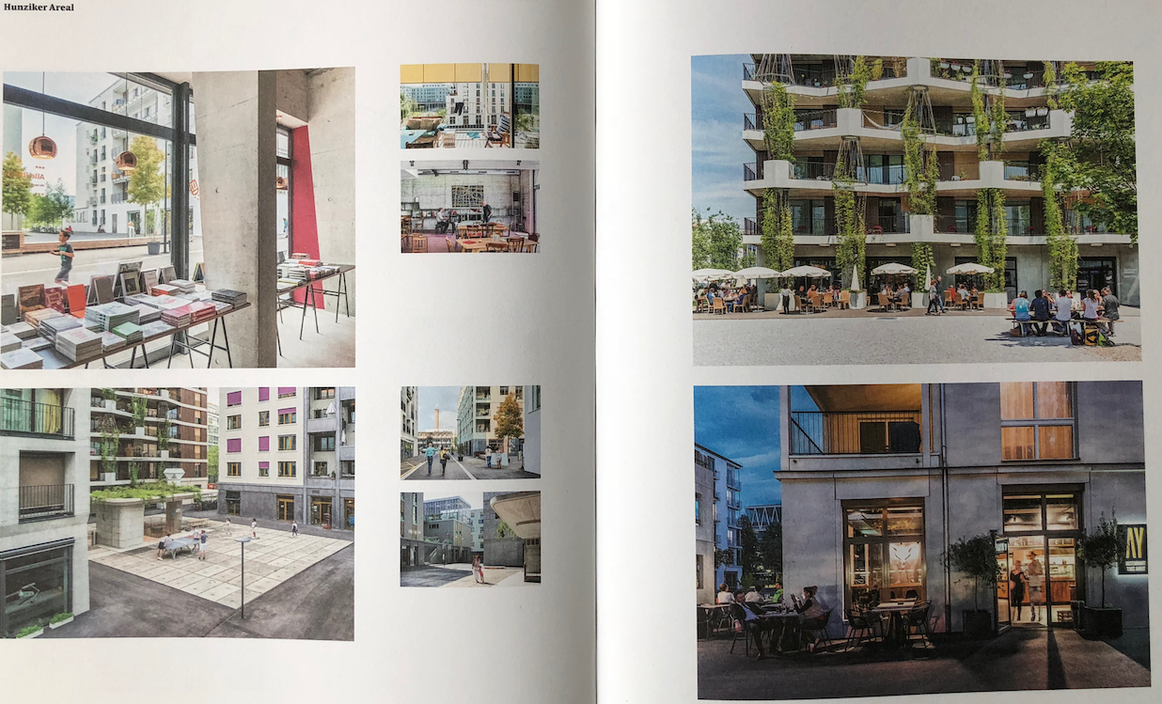
More! More than Housing!
Dr. Philipp Klaus, Kraftwerk 1 Housing Coop , INURA Zurich Institute // May 3, 2018 // INDI-CAT Conference, Viladecans, Barcelona Province.
Notes:
39

Slide 40
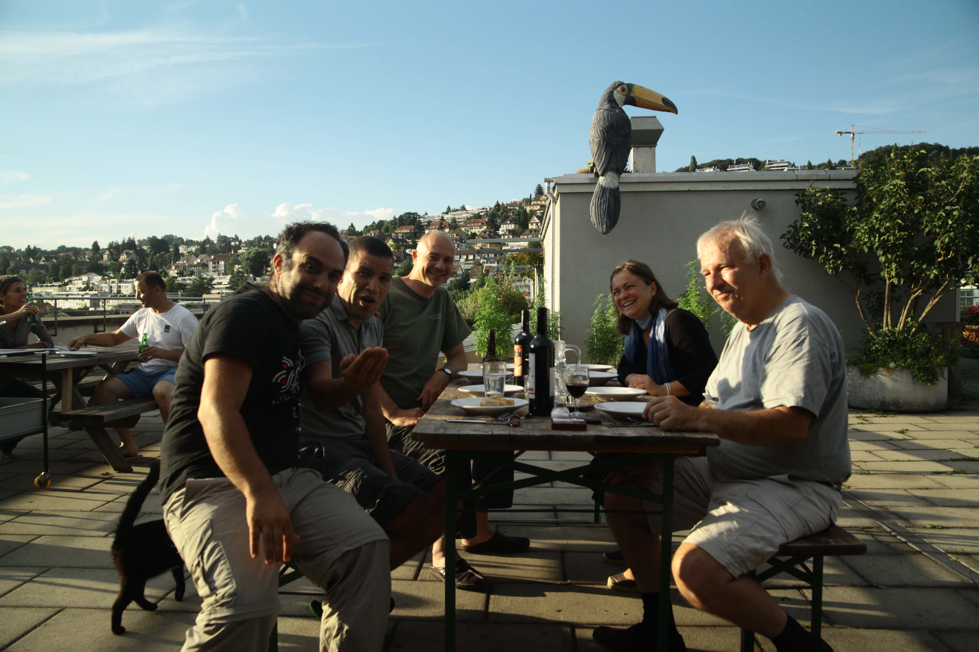
Cooperative Kraftwerk1, Leisure after Workshop, Zürich
MAZI Zurich Workshop
Philipp Klaus, INURA Zurich Institute
Notes:
40
New platform caused the collapse of the sign up system for the Konsumdepot, our shop.

Slide 41
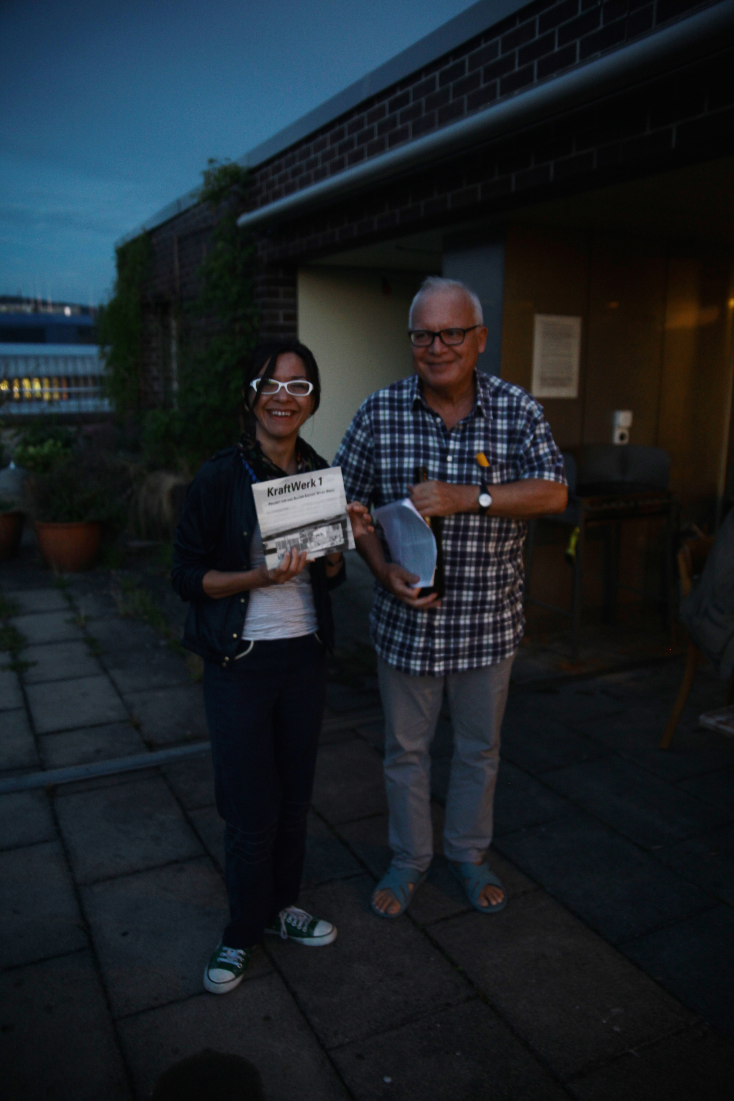
MAZI Zurich Workshop
Knowledge exchange Athens–Zurich (Konstantina with the writer p.m.) on the rooftop terrace Kraftwerk1
Philipp Klaus, INURA Zurich Institute
Notes:
41
New platform caused the collapse of the sign up system for the Konsumdepot, our shop.

Slide 42
CONCLUSIONS
Housing the 3rd Way
Economic Stability
Affordability
Innovation
Social responsibility
Community building
Ecological contribution
a step towards utopia ☺ thank you!
Notes:
42
New platform caused the collapse of the sign up system for the Konsumdepot, our shop.

